Slide 1
Intro to Fahrenheit 451
Lecture Notes, Background, and Themes

Slide 2
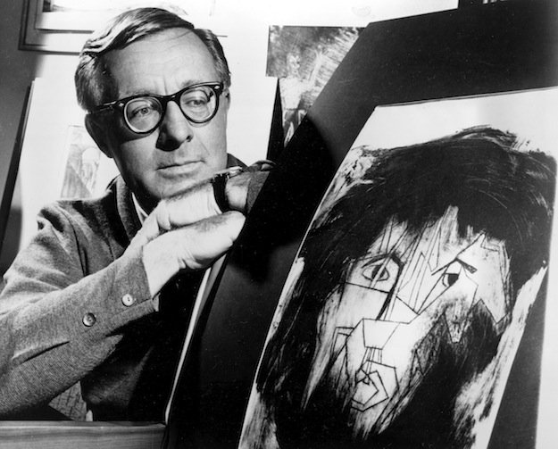
Ray Bradbury (1920-2012)
As a child, Bradbury recalls an intense fascination with monsters, magicians, and adventure films.
He began writing stories at the age of 12.
He wrote for Alfred Hitchcock and The Twilight Zone.
Bradbury is the author of more than 500 published literary works that include short stories, plays, novels, poetry, and screenplays.

Slide 3
The Life of a Writer
In 1940, Bradbury sold his first story.
In 1942, he was able to quit his newspaper job and write full-time.
His first novel was The Martian Chronicles, which describes humankind’s first attempt to colonize the planet Mars.
This novel combines science fiction with social commentary—an approach that characterizes much of his work.

Slide 4
Social Concerns
Bradbury’s works explored the threat of nuclear war, censorship, racism, conformity, and the dangers of technology—issues that still concern us today.

Slide 5
What do You Think?
Despite its benefits, technology can have unpredictable consequences on our society.
What are some of these potential consequences?

Slide 6
The Novel:
Fahrenheit 451 was published in 1953.
It is a novel of social criticism that warns against the dangers of suppressing thought through censorship.
It uses the conventions of science fiction to convey a message that “oppressive government, left unchecked, can do irreparable damage to society by limiting the creativity and freedom of its people”.

Slide 7
What is Social Criticism?
Social criticism analyzes (problematic) social structures, and aims at practical solutions by specific measures, radical reform, or even revolutionary change.
Fahrenheit 451 is a social criticism that warns against the danger of suppressing thought through the censorship of books.

Slide 8
Historical Context
Fahrenheit 451 was developed in the years immediately following World War II.
It condemns not only the anti-intellectualism of Nazi Germany (book burnings), but also America in the 1950s—the heyday of McCarthyism, and a growing fear of communism.
Other influential social criticisms of the time include George Orwell’s 1984 and Animal Farm.

Slide 9
The 1950s
By mid-century, nearly 60% of Americans were members of the middle class; they had more discretionary income.
Consumerism = Success
The electronics industry became the 5th largest industry. Television had a widespread impact in American homes.
The United States became an automobile culture.
The increase in prosperity after the war led to an increased passivity and conformity. Jobs were plentiful and the common adage of the time period was: “follow orders, and you will succeed.”

Slide 10
Personal Context
On a more personal level, Bradbury used Fahrenheit 451 as a means of protesting what he believed to be the invasiveness of editors, who, through strict control of the books they printed, impaired the originality and creativity of writers.

Slide 11
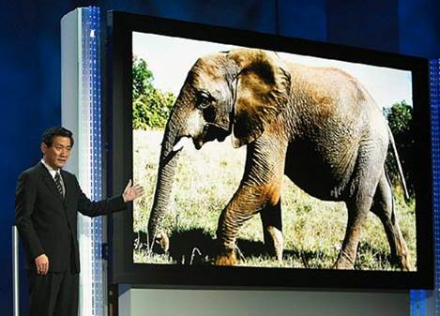
Bradbury Was Right…
In Fahrenheit 451, Bradbury tries to “prevent the future,” not predict it, but he actually does anticipate the future.
Seashell Radios
Parlor Walls
Population Explosion
A reliance on technology to mediate all social experience

Slide 12
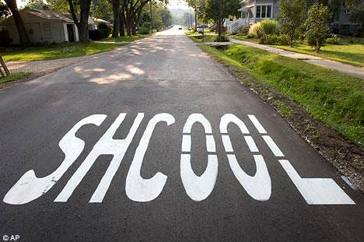
What Else was Bradbury Right About?
A rise in violence (including gun violence)
The use of televised surveillance footage for many purposes.
Growing illiteracy
The condensation of information into what we now call “sound bites.”

Slide 13
Themes: Censorship
Censorship is defined as the removal or withholding of information from the public by a controlling group or body.
Typically done by governments, religious and secular groups, corporations, or the mass media.

Slide 14
Censorship in the Novel
In the world of Fahrenheit 451, books are burned because they trigger thought and discontent, two things that are unwelcome in this “happiness oriented” society.
What’s unexpected about the censorship in Fahrenheit 451 is that it seems to have originated with the people, not the government.

Slide 15
Theme: Ignorance vs. Knowledge
What does true happiness consist of?
Is ignorance bliss, or do knowledge and learning provide true happiness?
In this world, firemen promote ignorance by destroying books—and with them—knowledge.

Slide 16
Theme: Technology-Deadening Human Experience
Technology in Bradbury’s 24th century is highly advanced and dominates society.
TV, radio broadcasts, fast cars and atomic weapons dominate people’s experiences—at the expense of things like nature, music and poetry.

Slide 17
Theme: Dystopian Society
an imagined place or state in which everything is unpleasant or bad, typically a totalitarian or environmentally degraded one.
The “Dystopia” motif, popular in science fiction—that of a technocratic and totalitarian society that demands order at the expense of individual rights—is central to the novel.

Slide 18
Dystopias
Characteristics
Types of Control
Propaganda is used to control citizens.
Information, independent thought, and freedom are restricted.
A figurehead or concept is worshipped by citizens.
Citizens are under constant surveillance.
Citizens feel trapped and struggle to escape.
The natural world is banished and distrusted.
Citizens are dehumanized.
The society is an illusion of a perfect utopian world.
Corporate/Economic: large corporations control society through products, advertising, and/or the media.
Political: red tape, relentless regulations and incompetent government officials.
Technological: society is controlled by technology—robots, computers, etc.
Philosophical/Religious: ideology is enforced through a dictatorship or theocratic government.

Slide 19
Can you think of any additional examples of dystopias in film or literature?

